Slide 1

Thesis and Dissertation Writing for St Cross
Methods and Findings
andrew.mitchell@lang.ox.ac.uk

Slide 2
Methods
This section might:
1) Introduce the section
2) Describe your Methods
Describe what methods you used.
Justify why you used those methods
3) Describe your data collection.

Slide 3
Methods
You might like to start by linking to the last paragraph or lines of the literature review:

Slide 4
Methods
You might like to start by linking to the last paragraph or lines of the literature review:
To examine if the frameworks of disruptive innovation and technical rationality can accurately predict challenges to a large scale IT system change in the public sector in Taiwan, I analysed data from the Taiwanese Ministry of Health and Welfare (MHW) using technique A and technique B.

Slide 5
Methods
You might like to start by linking to the last paragraph or lines of the literature review:
To examine if the frameworks of disruptive innovation and technical rationality can accurately predict challenges to a large scale IT system change in the public sector in Taiwan, I analysed data from the Taiwanese Ministry of Health and Welfare (MHW) using technique A and technique B.
Link to the end of the LR:

Slide 6
Methods
You might like to start by linking to the last paragraph or lines of the literature review:
To examine if the frameworks of disruptive innovation and technical rationality can accurately predict challenges to a large scale IT system change in the public sector in Taiwan, I analysed data from the Taiwanese Ministry of Health and Welfare (MHW) using technique A and technique B.
Introduce the major methods that you used:

Slide 7
Methods
You might like to start by linking to the last paragraph or lines of the literature review:
Describe technique X
and justify why I used it
Describe technique Y
and justify why I used it
Data Collection (Describe what I did in chronological order)
The rest of the Methods section could follow a pattern like this:

Slide 8
Methods
You might like to start by linking to the last paragraph or lines of the literature review:
Describe technique A and justify why I used it
Describe technique B and justify why I used it
Data Collection (Describe what I did in chronological order)
The rest of the Methods section could follow a pattern like this:

Slide 9
Methods: Justify a method
You might like to start by linking to the last paragraph or lines of the literature review:
To describe or justify an approach, you may wish to use present tense:

Slide 10
Methods: Justify a method
You might like to start by linking to the last paragraph or lines of the literature review:
For example,
Our framing of the interface between work and life brings together and draws on a broad range of concepts …
To describe or justify an approach, you may wish to use present tense:

Slide 11
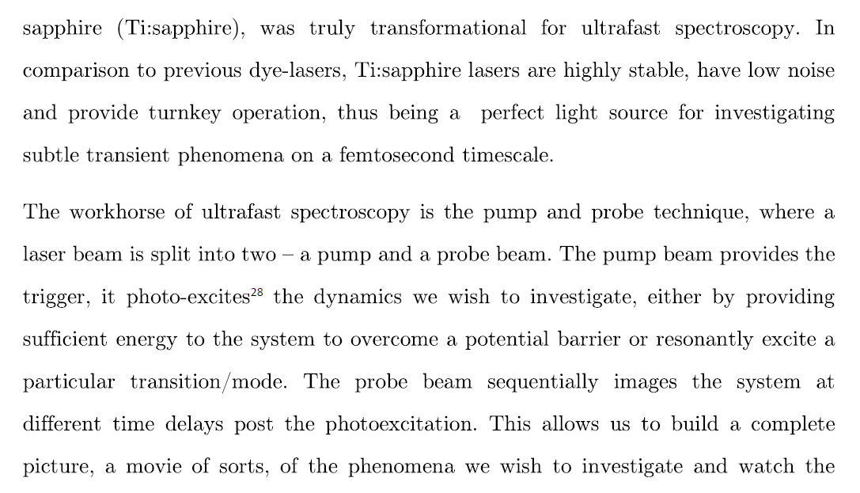
Methods: Justify a method
You might like to start by linking to the last paragraph or lines of the literature review:
To describe or justify an approach, you may wish to use present tense:

Slide 12
Methods
To describe your data collection, you may use past tense if your data collection occurred once in the past:

Slide 13
Methods
You might like to start by linking to the last paragraph or lines of the literature review:
For example,
To provide a review of the literature on work-life balance, I conducted a series of searches using the DI Web of Knowledge database … . Using the key words of work-life, work-family, balance, interface, conflict, fit, integration and spillover, I searched for peer-reviewed journal articles focusing on the nexus of work and life. My initial research returned 1195 articles in social science fields. I then limited the coverage only to works categorized as articles…
To describe your data collection, you may use past tense if your data collection occurred once in the past:

Slide 14
Methods
When describing your data collection, you could use an impersonal style:

Slide 15
Methods
You might like to start by linking to the last paragraph or lines of the literature review:
For example,
A series of searches using the DI Web of Knowledge database were conducted, using the key words of …
Peer-reviewed journal articles focusing on the nexus of work and life were indentified.
1195 articles were returned in social science fields.
When describing your data collection, you could use an impersonal style:

Slide 16
Methods
You might like to start by linking to the last paragraph or lines of the literature review:
A series of searches using the DI Web of Knowledge database were conducted, using the key words of …
Peer-reviewed journal articles focusing on the nexus of work and life were indentified.
1195 articles were returned in social science fields.
This style uses past simple passive and avoids using “I”. Whilst it is the traditional science writing style, it might make your description cumbersome or wordy. However, some teachers may prefer it:

Slide 17
Methods
You might like to start by linking to the last paragraph or lines of the literature review:
.
Use active formulations to create clearer, simpler text.

Slide 18
Methods
You might like to start by linking to the last paragraph or lines of the literature review:
I conducted a series of searches using the DI Web of Knowledge database using the key words.
I searched for peer-reviewed journal articles focusing on the nexus of work and life.
My initial research returned 1195 articles in social science fields. I then limited the coverage only to works categorized as articles…
.
Use active formulations to create clearer, simpler text.

Slide 19
Methods
But definitely avoid mixing personal and impersonal style!
You might like to start by linking to the last paragraph or lines of the literature review:
A series of searches using the DI Web of Knowledge database were conducted, using the key words of … I searched for peer-reviewed journal articles focusing on the nexus of work and life. 1195 articles in social science fields were returned. I then limited the coverage only to works categorized as articles…
.

Slide 20
Findings

Slide 21
Findings
This section should:
present the results of your research systematically, following a similar organisation to the data collection section in Methods.
describe your results, but do not link them to previous research or your research questions or hypotheses.

Slide 22
Findings
Or for even more clarity, use active:
Figure 3.4 details the findings.

Slide 23
Findings
Qualitative data may need to be organised into themes and summarised:
Sub-Theme 2: Adjustment Difficulties
More than half of the interviewed returnees told me that their friends struggled with processing the adjustment difficulties they experienced after returning home.

Slide 24
Findings
Qualitative data may need to be organised into themes and summarised:
Sub-Theme 2: Adjustment Difficulties
More than half of the interviewed returnees told me that their friends struggled with processing the adjustment difficulties they experienced after returning home.

Slide 25
Findings
To distinguish them from generalised claims, writers often use past tense to describe findings:

Slide 26
Findings
You should use past simple to describe your findings.
More than half of the interviewed returnees told me that their friends struggled with processing the adjustment difficulties they were experiencing as a result of returning home. Some mentioned that various acquaintances made sparse attempts when they first arrived, and could not fully comprehend. For example:

Slide 27
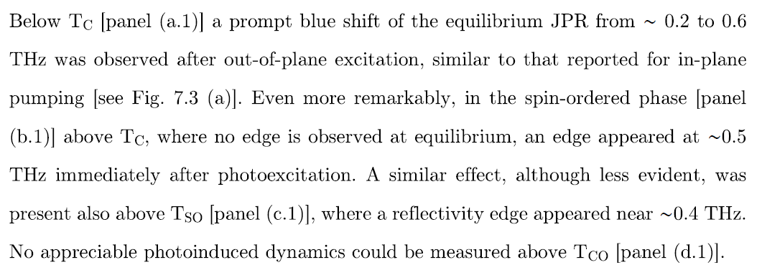
Findings

